Slide 1
ACCIDENT/INCIDENT OCCURRENCE IN WORKPLACE ENVIRONMENT: THE ROLE, RESPONSIBILITY AND CHARACTERISTICS OF SAFETY ENGINEERS. ENGR SAMUEL SHOKUNBI FNISafetyE, MNSE, MNIEEE, MNIEE, FIRSM, FIMC, CMC, MISPON, MIPMAN, MISMN, MTECH, MBA.

Slide 2
ABSTRACT
The President, the Nigerian Society of Engineers, Engr. Tasiu S. Gidari-Wudil, FNSE, FNISafetyE, The National Chairman, Nigerian Institution of Safety Engineers, Engr.Akaninyene Ekong, MNSE, FNISafetyE, Distinguished Engineers/Participants, I stand on established protocol to underline in fact and truth, that the accidents/incidents occurrence in the workplace environment is NERVE WRENCHING.
My assignment is to throw searchlight on the challenges and the decisions to be implemented towards ensuring safe work practice. I have been given few minutes to speak.
My understanding is that there is loss professional integrity. If care is not taken, there will be no bright future for safety Engineers to look forward to.
My assumption are that as participants, we stand on the same page from the perspective of safety Engineering challenges at the workplace environment. First, I have to define my impression of an Engineer; An Engineer does things required to serve the needs of his environment by ensuring that standard (safety code of practice) is not compromised. Also, an Engineer manages the framework of process and procedure used by ensuring that all tasks required to achieve safety during practice is maintained and; embraced safety culture in order to protect human life and property.

Slide 3
I will follow with some light on “who is safety Engineer?”
A safety Engineer bridge the gap between safety and quality in accordance with standard code of practice of both local (Factories Act, SON, NERC etc.) and international (ISO, OSHA, OHSAS, ILO, WHO etc.) for compliance purposes
Also, safety Engineer is the driver of safety right from project/equipment design, installation, commissioning, operations and maintenance/repairs.
The role, responsibility and characteristics of a safety Engineer in the society is to maintain professional discipline, ethics and safety standards. Therefore, an acceptable safety standard is deeply embedded in engineering system of practice.
I will thereafter, shine more light on the state of accident/incident report at workplace (ELECTRICITY WORKERS). Because of time constraints, I will x-ray the occurrence on Organization/Management peephole; Agencies/Regulators peephole; and Professional body’s peephole. Often time we hear safety is everyone business

Slide 4
ORGANIZATION/MANAGEMENT PEEPHOLE
Failure of good management system in place are found to be direct or indirect factors in accidents at workplace. Based on the severity of incident/accident occurrences, there is need for Engineers to be appointed as a leader or management representative for effectiveness and implementation of standard task in order to protect human life and property
However, due to a lack of good safety culture and poor implementation of policies. The accident/incident frequency rate is on the increase with a lot going unreported to the regulators/agencies. It is good to know that some organization don’t have a systematic and structured process of accident/incident arising from operational activities. To apply control measures to acceptable levels of priorities all risks need to be identified and evaluated provided the risk is known, it will be difficult to control unsafe act and unsafe condition practice in the workplace
All personnel must take reasonable care not only to protect themselves but also their colleague because everyone have a duty to work safely

Slide 5
AGENCIES/REGULATORS PEEPHOLE
In line with Factories Act CAP F1 Law of the federation of Nigerian 2004 and several other local and International laws/Guidelines for compliance purposes which is the key to maintain safety policy standards in the workplace environment.
However, the statutory Agencies/regulators often compromised. That is the reason of why we are having these issues so if they are to do what is right, they need to do it properly because it’s all about human life and property.
Unless something changes, the death toll in workplace environment will continue to rise for example; This Day Newspaper of May 2020 reported that “in its report for the second quarter of 2019, the Nigerian Electricity Regulatory Commission (NERC) lamented that no few that three persons were electrocuted every week. In the last quarter of 2018, there were 136,393 complaints from customers about the negligence of the electricity distribution companies (DISCO) but by the first quarter of 2019, the complaints had jumped to 151,938 while the body counts continue to mount.
Also, it was reported in Business Day Newspaper in January 2022 that 335 Electricity workers died in 5 years which is due to lack of training and re-training of personnel, which has created an unhealthy atmosphere for the concern environment.

Slide 6
PROFESSIONAL BODY’S PEEPHOLE
Yes, safety is everyone business but as an Engineer, everybody’s safety is our top priorities and responsibility as it relates to Engineering equipment competency and operational risk management. Safety is like a lock, an Engineer is the key to open it. Therefore, a safety Engineer does things required to serve the needs of his environment by ensuring that the safety code of practice (Safety at work ACT 1974, safe work practice 1910:147, control of work regulations 2005, Risk management OSHA 1910: 119 etc.) Is not compromised.
Also, there is need for our institution (Nigerian Institution of Safety Engineers) to promote the integration of safety engineering practice in the workplace environment using a business – like approach such as:
To partner with relevant agencies/regulators and industrial sectors
To organize training/seminar for work force on technical acquisition
To engage in routine technical services
To create an awareness on incidents/accidents reduction and unsafe act practices
Compliance to statutory requirements
Zero tolerance adoption

Slide 7
Finally, the correlation between safety and standards in Engineering practice, is that Engineers bridge the gap between safety and standards. Safety standards have become invaluable for purpose of protecting human life and property in the workplace environment.
There is no assumption in safety, because safety is priceless. The door to safety swings on the hinges of common sense.
Awareness and sensitization is the key to compliance acceptability. It is better to be informed than to be deformed. So, safe action brings lasting satisfaction. Safe operators are smooth operators, if you do it right you will enjoy the benefits because safety is a continuing journey, not a final destination. Safety Engineers are the enabling hands in workplace safety.
In conclusion, Safety is good for business and stimulates economic growth, with high level profitability. Working without safety is a DEAD end job.

Slide 8
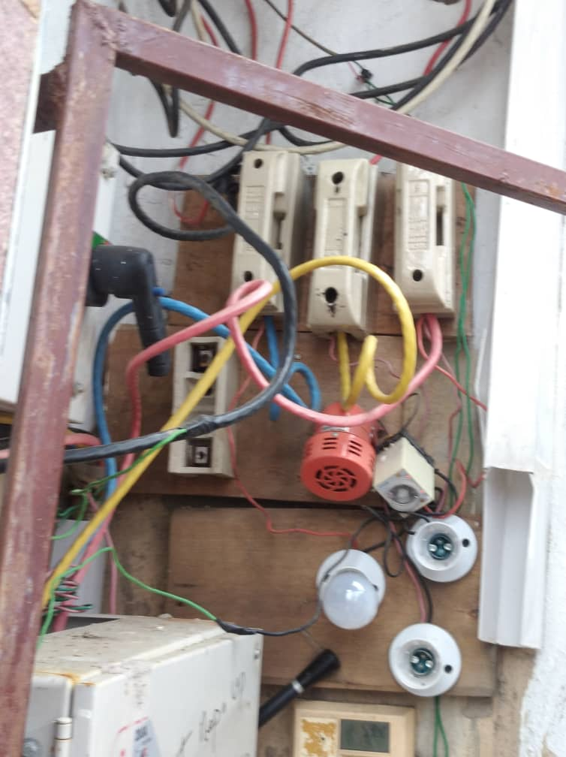
PICTORIAL REPRESENTATION

Slide 9
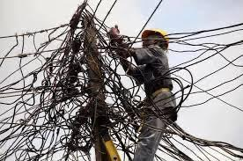
PICTORIAL REPRESENTATION

Slide 10
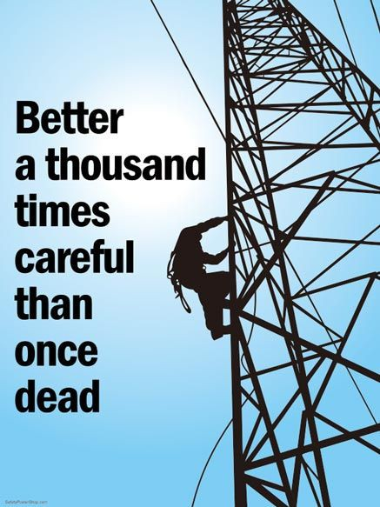
PICTORIAL REPRESENTATION

Slide 11
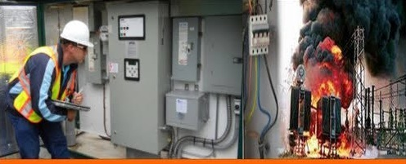
PICTORIAL REPRESENTATION

Slide 12
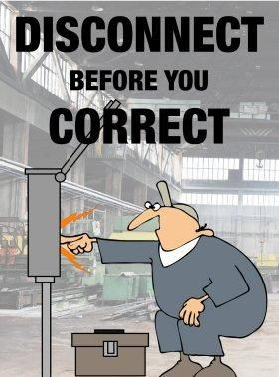
PICTORIAL REPRESENTATION

Slide 13
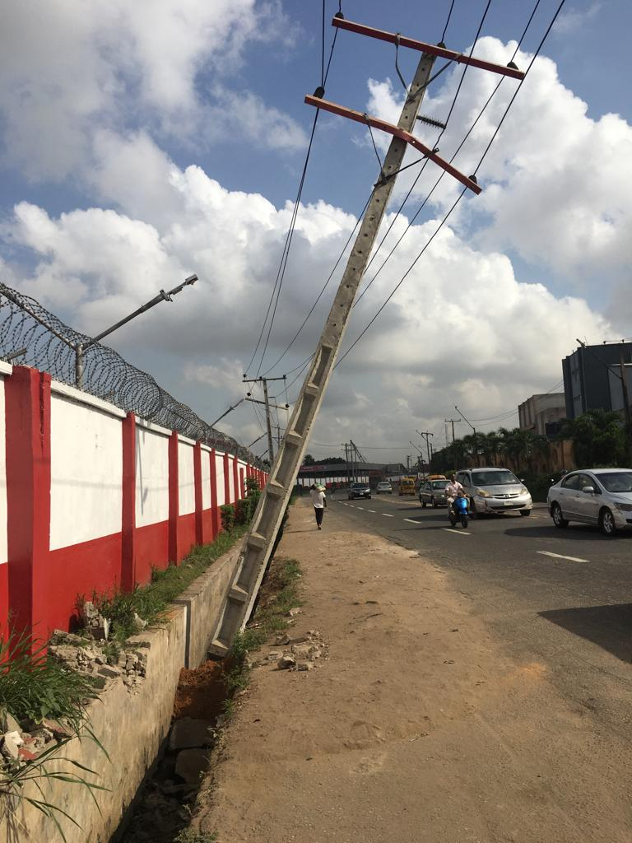
PICTORIAL REPRESENTATION

Slide 14
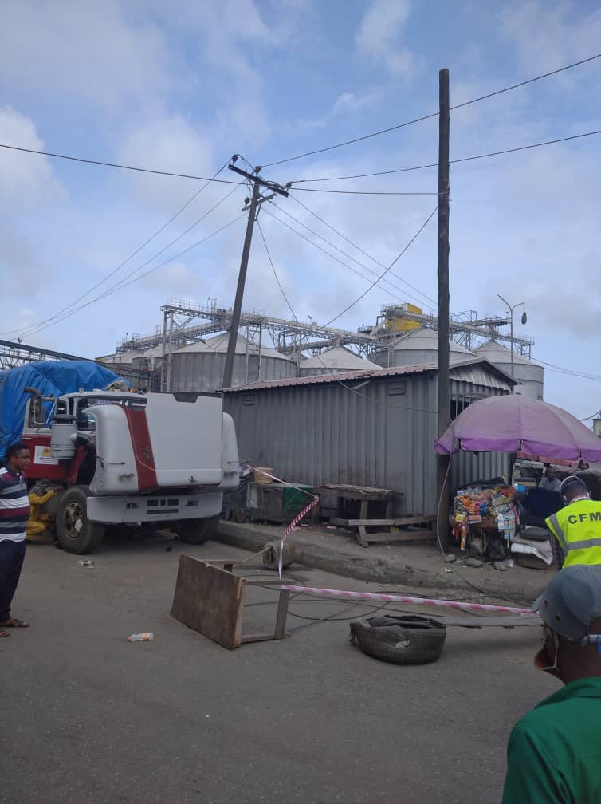
PICTORIAL REPRESENTATION

Slide 15
PROFESSIONAL OPERATING FRAMEWORK
There is dignity in professional practice. Let us attest to the statement below.
A lawyer’s income increases with increase in crime and litigation
While doctor’s income increases with increase in disease/illness but an Engineer’s income increases with increase in prosperity of people and Nation.
Therefore, I’m very proud to be “an Engineer”
KEYWORDS: Safety & Standards, Safety rules, safe act practice, code of practice, safety and quality, professionalism work-related injuries, awareness and sensitization, compliance acceptability, negligence, safety culture control measures etc.)

